Slide 1
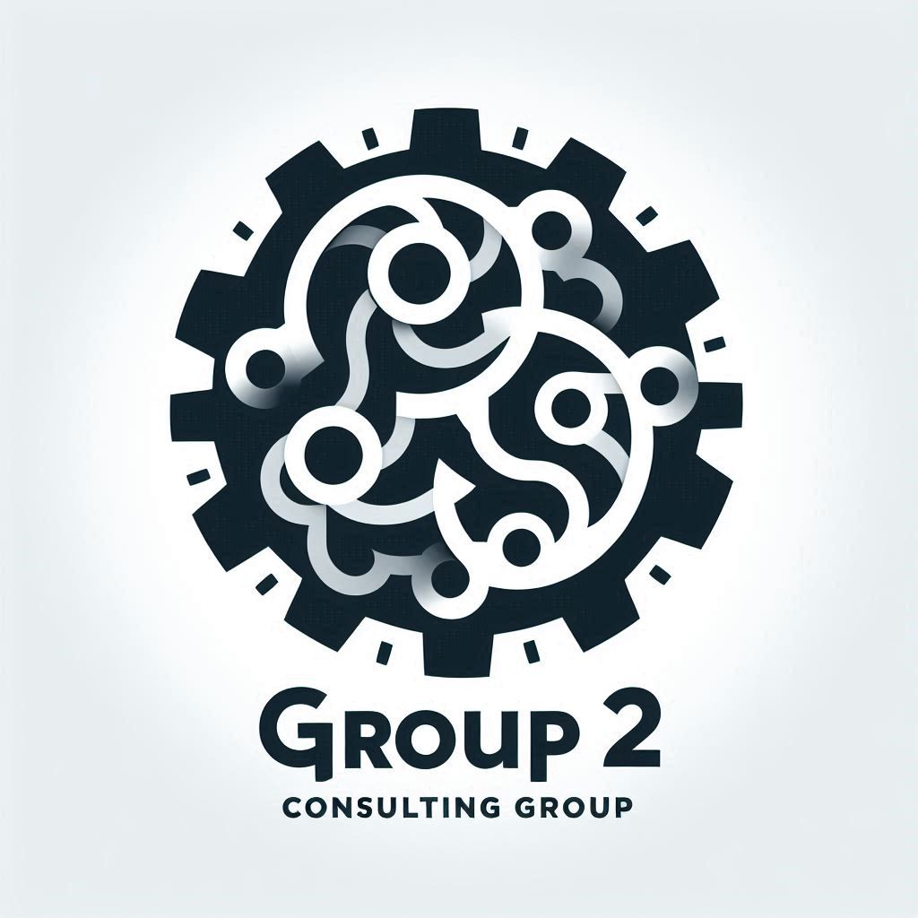
The Group 2 Consulting Group (G2CG)
…an AWS cloud solutions consultancy

Slide 2
Project #1
Client
TechStyle Inc
Project
Optimization and modernization of CustomThread’s infrastructure to improve performance, ensure PCI compliance and reduce day-to-day management efforts
Key Deliverables
Presentation of proposed solution – PowerPoint deck
Proposed architecture
Diagram
Components
Web Tier services and technologies
Database Tier services and technologies
Backup & Recovery strategies
Describe how architecture addresses client’s must-haves
Security Measures for both web and database tiers
How does measures achieve PCI compliance
Availability and Redundancy strategies
Cost Optimization measures
Client Must-Haves
Performance Optimization: application performs well during peak hours
Security and Compliance: Achieve PCI compliance; enhanced security
Scalability: Scalable architecture to handle future growth
Cost Optimization: Must be a cost-efficient solution
Low Maintenance: Requires minimal day-to-day management

Slide 3
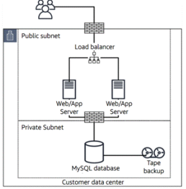
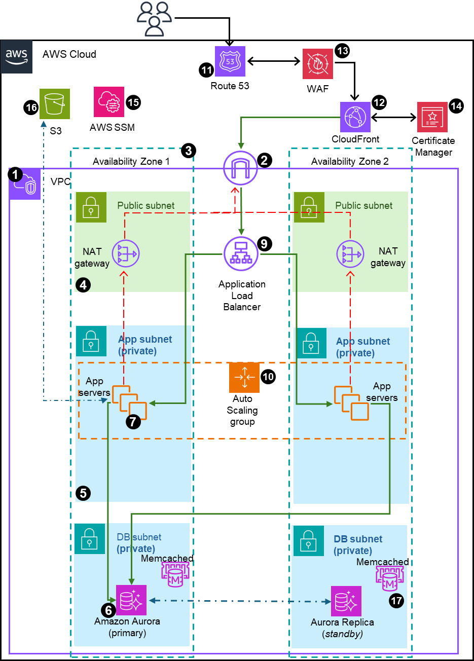
Proposed Solution – High-level Basics
From Here
(on-prem)
To Here
(AWS Cloud)
Replatform CustomThread infrastructure from on-premises to AWS cloud
New network is VPC with multiple AZs (vs single) for high availability & reliability
3-tier architecture with all servers in private subnets for additional security
Right-size servers based on workload history
Add ALB – traffic balancing plus server health checks
ASG to scale out servers in peak traffic and scale in during down times
Migrate DB to AWS Aurora for speed, multi-AZ replicas, automatic failover, autoscaling (read replica and size scaling)
Add S3 for added storage – backups, customer files (images, videos), logs
Enable AWS Backup for automatic backup of DB and Server snapshots
Enable Cloudfront for improved latency and frontline for SSL/TSL data encryption
Enhanced monitoring, alarms and alerts

Slide 4




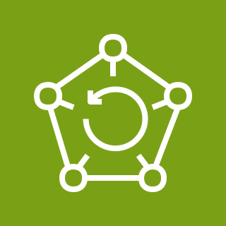
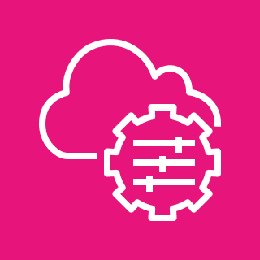












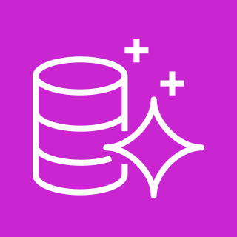
Proposed Architecture
How architecture addresses customer must-haves
Performance
AWS’s ALB performs server health checks and routes traffic only to healthy instances – this ensures only healthy and running instances receive traffic
ASG responds to traffic alarms by adding instances during peak traffic and scaling out when traffic reverts; ASG also responds to health checks by terminating unhealthy instances and spinning up new ones – maintaining availability of adequate resources for client’s workload
Aurora DB is an optimized DB with 5X speed of regular DB; Aurora has automatic failover to read replica, ensuring reliability and performance of client’s network
CloudFront CDN’s caching uses edge locations around the world to reduce latency and improve load times
Security
Web/App tier servers in private subnets (access only through SSM or SSH on a bastion in the public subnet) (NAT gateways only for one-directional internet access)
DB tier instances also in private isolated subnet; NACLs restrict access to traffic from Web/App tier
Security Groups used to control all inbound and outbound traffic
only ALB traffic allowed into the Web/App tier, and SSH port opened to access from public subnet via Bastion
Only traffic from Web/App tier allowed into the DB tier
SSL encryption via AWS Certificates Manager ensures customer’s payment information, personal data, etc. are encrypted while in transit
Data-at-Rest can be enabled for data in S3, DB
S3 Access management- restrict public access
4 & 5 above help with PCI compliance
WAF and Shield for application level and network protection against attacks
Scalability for future group
New subnets can be added to existing VPC to for additional resources
ASG can scale-out as much as needed to support growth
S3 storage automatically scales for more capacity
Aurora DB can add read replicas for read scaling, as well as DB storage scaling; also supports cross-region replication
Serverless options available for infinite scaling
Cost Optimization
Reserved instances and on-demand during scale-out
AWS tools – Cost Explorer and Budget- for line of sight to costs management
S3 tiers and lifecycle policies to save costs
Low Maintenance
AWS Backup for automated backup with retention policies
Aurora DB is managed services – automatic backup, automatic failover, and automatic scaling with little manual intervention
ASG handles server scaling automatically on demand
Monitoring & Alerts alarms based on thresholds, and SNS for alerts; also can use managed services like Lambda to create automatic actions triggered by alarms
SSM patch manager for automatic patching of managed instances with timely security updates
AWS CloudFormation automates provisioning, management, deployment and retirement of resources
Automatic tracking of costs and budgets via cost explorer
AWS Cloud
VPC with public and private subnets in 2 availability zones
Internet Gateway to allow communication between instances in VPC and internet
Two Availability Zones for high availability and fault tolerance
Public subnet to house resources like NAT gateway, Application Load Balancers and Bastion (we will replace bastion with SSM session manager)
App and DB servers will be placed in Private subnets
AWS Aurora with primary and replica mysql databases in different AZ to ensure high availability and resilience to failures
EC2 instances with the appropriate IAM roles and permissions to host web application
Amazon EFS to allow application to access shared storage ensuring persistent storage across instances
Application Load Balancer (ALB) to distribute traffic across an auto-scaling group of EC2 instances in multiple AZs.
Auto Scaling Group (ASG) to dynamically create EC2 instances to make web application highly available, scalable, fault-tolerant and elastic
Route 53 to set up DNS, direct traffic and domain management, and failover
CloudFront for global content caching, and SSL termination for data-in-transit encryption
WAF to protect application from web attacks that will compromise security consume resources and affect availability
Certificate Manager to create and manage the SSL/TSL encryption certification
Systems Manager to manage the resources – session manager for access (w/o need for ssh or bastion), patch manager for updates, etc
S3 to store static files, static website for failover, and back-up storage, and general storage
Backup using AWS Backup for S3 and DB
Other possible architecture considerations
Integrate monitoring and alerting – CloudWatch, etc
Improved governance – use AWS Control Tower to create Ous – Security OU, Test OU, DevOps OU and Production OU
13
AWS Backup
11
17
Route 53
WAF
15
12
14
16
AWS SSM
CloudFront
Certificate Manager
S3
3
Availability Zone 1
2
Availability Zone 2
1
VPC
Public subnet
Public subnet
NAT gateway
9
NAT gateway
4
Application
Load Balancer
App subnet (private)
App subnet (private)
Auto
Scaling
group
App servers
10
App servers
7
5
DB subnet (private)
DB subnet (private)
Memcached
Memcached
6
17
Amazon Aurora (primary)
Aurora Replica
(standby)

Slide 5
Description of Architecture Number Callouts
VPC with public and private subnets in 2 availability zones
Internet Gateway to allow communication between instances in VPC and internet
Two Availability Zones for high availability and fault tolerance
Public subnet to house resources like NAT gateway, Application Load Balancers and Bastion (we will replace bastion with SSM session manager)
App and DB servers will be placed in Private subnets
AWS Aurora with primary and replica mysql databases in different AZ to ensure high availability and resilience to failures
EC2 instances with the appropriate IAM roles and permissions to host web application
Amazon EFS to allow application to access shared storage ensuring persistent storage across instances
Application Load Balancer (ALB) to distribute traffic across an auto-scaling group of EC2 instances in multiple AZs.
Auto Scaling Group (ASG) to dynamically create EC2 instances to make web application highly available, scalable, fault-tolerant and elastic
Route 53 to set up DNS, direct traffic and domain management, and failover
CloudFront for global content caching, and SSL termination for data-in-transit encryption
WAF to protect application from web attacks that will compromise security consume resources and affect availability
Certificate Manager to create and manage the SSL/TSL encryption certification
Systems Manager to manage the resources – session manager for access (w/o need for ssh or bastion), patch manager for updates, etc
S3 to store static files, static website for failover, and back-up storage, and general storage
Backup using AWS Backup for S3 and DB
Other possible architecture considerations
Integrate monitoring and alerting – CloudWatch, etc
Improved governance – use AWS Control Tower to create Ous – Security OU, Test OU, DevOps OU and Production OU

Slide 6
How Architecture Address Customer Needs
Performance
AWS’s ALB performs server health checks and routes traffic only to healthy instances – this ensures only healthy and running instances receive traffic
ASG responds to traffic alarms by adding instances during peak traffic and scaling out when traffic reverts; ASG also responds to health checks by terminating unhealthy instances and spinning up new ones – maintaining availability of adequate resources for client’s workload
Aurora DB is an optimized DB with 5X speed of regular DB; Aurora has automatic failover to read replica, ensuring reliability and performance of client’s network
CloudFront CDN’s caching uses edge locations around the world to reduce latency and improve load times
Security
Web/App tier servers in private subnets (access only through SSM or SSH on a bastion in the public subnet) (NAT gateways only for one-directional internet access)
DB tier instances also in private isolated subnet; NACLs restrict access to traffic from Web/App tier
Security Groups used to control all inbound and outbound traffic
only ALB traffic allowed into the Web/App tier, and SSH port opened to access from public subnet via Bastion
Only traffic from Web/App tier allowed into the DB tier
SSL encryption via AWS Certificates Manager ensures customer’s payment information, personal data, etc. are encrypted while in transit
Data-at-Rest can be enabled for data in S3, DB
S3 Access management- restrict public access, VPC endpoints to access
4 & 5 above help with PCI compliance
WAF and Shield for application level and network protection against attacks

Slide 7
How Architecture Address Customer Needs
Scalability for future group
New subnets can be added to existing VPC to for additional resources
ASG can scale-out as much as needed to support growth
S3 storage automatically scales for more capacity
Aurora DB can add read replicas for read scaling, as well as DB storage scaling; also supports cross-region replication
Serverless options available for infinite scaling
Cost Optimization
Reserved instances and on-demand during scale-out
AWS tools – Cost Explorer and Budget- for line of sight to costs management
S3 tiers and lifecycle policies to save costs
Low Maintenance
AWS Backup for automated backup with retention policies
Aurora DB is managed services – automatic backup, automatic failover, and automatic scaling with little manual intervention
ASG handles server scaling automatically on demand
Monitoring & Alerts alarms based on thresholds, and SNS for alerts; also, can use managed services like Lambda to create automatic actions triggered by alarms
SSM patch manager for automatic patching of managed instances with timely security updates
AWS CloudFormation automates provisioning, management, deployment and retirement of resources
Automatic tracking of costs and budgets via cost explorer

Slide 8
Performance Optimization (Yvette)
Bla bla bla

Slide 9
Security (Leonard)
Bla bla bla

Slide 10
Availability and Redundancy (Precious)
Bla bla bla

Slide 11
Cost Optimization (Kingsley)
Bla bla bla

Slide 12
Low Maintenance (Leslie)
Bla bla bla

Slide 13
Scalability (…)
Bla bla bla

Slide 14
Web/App Tier Description (Olayinka)
Bla bla bla

Slide 15
Database Tier Description (….)
Bla bla bla

Slide 16
Backup & Recovery (Alain)
Bla bla bla

Slide 17
Obinna- brain dump
 | Feature | Existing Platform | New Platform (AWS Cloud)
Network & Infra | Network | Private network (data center) | VPC
 | Subnets | Two - one public and one private Not scalable | 3-tier but scalable - can add more subnets for even more isolation of resources
 | Load balancer | Load balancer | Application load balancer
 | Servers | 2 Application servers | On-demand scalability - can scale out to 4 (or more), scale in to 1 can vertically scale to higher performance servers if needed
 | DB | MySQL | AWS Aurora w/ MySQL - highly scalable (read replicas), faster, highly available across multi-Azs, automatic failover
 | Storage / backup | Weekly backup, on-Tape storage for DB | Continuous backup with AWS Backup to S3 AWS S3 is on auto replication across multiple Azs
Performance | Load distribution | Yes | Yes - ALB goes beyond to performance health checks
 | Scaling for peak traffic | No - constrained to 2 servers | Yes - can scale out (and scale in to save costs) using ASG
 | DB access | MySQL - base speed, base storage | Aurora MySQL optimized for 5X speed (distributed storage) -scalable read capacity with up to 15 read replicas -auto-scaling of storage -optional Memcached for even faster read access
 | Web latency improvement | None | AWS CloudFront using Edge locations for global caching, reduced latency

Slide 18
Obinna- brain dump
 | Feature | Existing Platform | New Platform (AWS Cloud)
Security & PCI Compliance | Servers & DB vulnerability | - Web & App servers are in public subnet and highly vulnerable DB is in private subnet | Web & App servers in private subnets with NAT gateway for one-directional access to internet (ssh via bastion host or SSM session manager needed for access) DB and replicas are in private subnets
 | Firewalls: Security Groups & NACLs | Not clear | Yes, controls access (inbound & outbound traffic) to the instances (servers and DBs) and subnets
 | Data encryption | Not clear | TSL/SSL encryption via AWS Certificate Manager -protects customer data (credit card info, etc) from interception Optional data-at-rest encryption (s3, EBS & RDS), uses AWS KMS
 | Network and Application Layer Protection | None | AWS WAF(paid) protects from web exploits - SQL injection, etc using custom rules to block traffic AWS Shield (free) protects against DDoS
 | IAM | None | Account access management - Roles for applications, MFA for users, permission (least privilege permission) and Groups management
 | Logging | None | Highly advanced logging tools for threat monitoring & detection How-to: store logs in S3; Athena to Query; Quicksights to analyze and visualize Log-types for sucurity: -AWS Config- monitor and log security-related changes in AWS resources, such as security groups, IAM roles, and S3 bucket policies -AWS CloudTrail- to log API calls, and track user activity, detect unauthorized access, and audit AWS account activities -CloudWatch- to monitor application and infrastructure logs for security anomalies, like unauthorized login attempts or unusual error rates -VPC Flow Logs- to monitor network (IP) traffic and detect anomalous traffic patterns that may indicate security incidents. -GuardDuty- Detect potential security threats, such as EC2 instances compromised by malware, unusual API activity -WAF Logs- monitor for web application threats such as SQL injection or cross-site scripting (XSS) attacks -AWS Security Hub - centralize security findings and insights

Slide 19
Obinna- brain dump
 | Feature | Existing Platform | New Platform (AWS Cloud)
High Availability / Fault Torelance / Redundancy / Reliability | Zonal Redundancy | One zone only - Servers & DB on one zone -risk of complete failure if location is compromised | Two or more Availability zones -ensure HA in case one or more zones are down -new servers can be spin up in healthy zones -DB replication in multiple AZ
 | Servers | Two servers only - if one is unhealthy and down, remaining can be over-worked and crash | ALB monitors health of servers and ASG can retire unhealthey and spin up new healthy serves to keep workload within tolerance
 | DB | One DB, no replication, backup and manual recovery in case of failure | One DB and multiple replicas; failover to replica is automatic ensuring reliability
 | Storage | File storage (customer images, metadata, etc) stored in server instances or DB | S3 used to store customer-generated or uploaded images DB used to metadata storage
 | Backup / Recovery | Back-up on Tape, failure of tape is relliability issue | Backup into S3 buckets; and S3 buckets are replicated in multiple AZs - ensures high availablity and reliabilty of backups when needed
 | Feature | Existing Platform | New Platform (AWS Cloud)
Cost Optimization | Infrastruture cost | One time cost; difficult to plan for scale | Pay for resources used and data transferred - optimize resource choice - i.e. choose the right instance type based on workload -Use S3 storage tiers and lifecycle policies to save costs -Use DB Autoscaling to add additional storage to DB (pay for necessary capacity only) - use Reserved Instanced (or Savings Plan) for Desired # of servers; use On-Demand for scale-out during peak traffic - AWS cost explorer and AWS budgets to track and manage spending; use dashboard to track
Scalability | Network | Discrete, will need to physically add new infrastructure | -Many options to scale as business grows 1. Servers can be added via ASG and hooked up to the ALB 2. New subnets can be created on existing VPC for additional resources 3. S3 is scalable storage and automatically svales 4. Aurora DB can scale - more read replicas to distribute read traffic and multi-AZ deployment for HA and failover; Also supports cross region replication 5. Option for serverless migration - infinitely scaling services
Low Maintenance |  | None | -Automated backup with retention policies via AWS Backup -Use AWS Managed Services -Aurora DB provides automatic backup, automatic failover and automatic scaling with minimal manual intervention -ASG handles server scaling automatically based on demand -Monitoring & Alerts: set up alarms based on thresholds, and SNS for alerts; also can use managed services like Lambda to create automatic actions triggered by alarms -SSM patch manager for automatic patching of managed instances with timely security updates -AWS CloudFormation automates provisioning, management, deployment and retirement of resources -Automatic tracking of costs and budgets via cost explorer

Slide 21
Back-ups
VPC with public and private subnets in 2 availability zones
Internet Gateway to allow communication between instances in VPC and internet
Two Availability Zones for high availability and fault tolerance
Public subnet to house resources like NAT gateway, Application Load Balancers and Bastion (we will replace bastion with SSM session manager)
App and DB servers will be placed in Private subnets
AWS Aurora with primary and replica mysql databases in different AZ to ensure high availability and resilience to failures
EC2 instances with the appropriate IAM roles and permissions to host web application
Amazon EFS to allow application to access shared storage ensuring persistent storage across instances
Application Load Balancer (ALB) to distribute traffic across an auto-scaling group of EC2 instances in multiple AZs.
Auto Scaling Group (ASG) to dynamically create EC2 instances to make web application highly available, scalable, fault-tolerant and elastic
Route 53 to set up DNS, direct traffic and domain management, and failover
CloudFront for global content caching, and SSL termination for data-in-transit encryption
WAF to protect application from web attacks that will compromise security consume resources and affect availability
Certificate Manager to create and manage the SSL/TSL encryption certification
Systems Manager to manage the resources – session manager for access (w/o need for ssh or bastion), patch manager for updates, etc
S3 to store static files, static website for failover, and back-up storage, and general storage

Slide 22


VPC with public and private subnets in 2 availability zones
Internet Gateway to allow communication between instances in VPC and internet
Two Availability Zones for high availability and fault tolerance
Public subnet to house resources like NAT gateway, Application Load Balancers and Bastion (we will replace bastion with SSM session manager)
App and DB servers will be placed in Private subnets
AWS Aurora with primary and replica mysql databases in different AZ to ensure high availability and resilience to failures
EC2 instances with the appropriate IAM roles and permissions to host web application
Amazon EFS to allow application to access shared storage ensuring persistent storage across instances
Application Load Balancer (ALB) to distribute traffic across an auto-scaling group of EC2 instances in multiple AZs.
Auto Scaling Group (ASG) to dynamically create EC2 instances to make web application highly available, scalable, fault-tolerant and elastic
Route 53 to set up DNS, direct traffic and domain management, and failover
CloudFront for global content caching, and SSL termination for data-in-transit encryption
WAF to protect application from web attacks that will compromise security consume resources and affect availability
Certificate Manager to create and manage the SSL/TSL encryption certification
Systems Manager to manage the resources – session manager for access (w/o need for ssh or bastion), patch manager for updates, etc
S3 to store static files, static website for failover, and back-up storage, and general storage
Add Backup using AWS Backup for S3 and DB
Other possible architecture considerations
Integrate monitoring and alerting – CloudWatch, etc
Improved governance – use AWS Control Tower to create OUs – Security OU, Test OU, DevOps OU and Production OU
Migration
AWS Cloud
13
11
Route 53
WAF
16
15
12
14
S3
AWS SSM
CloudFront
Certificate Manager
3
Availability Zone 1
2
Availability Zone 2
1
VPC
Public subnet
Public subnet
NAT gateway
9
NAT gateway
4
Application
Load Balancer
App subnet
App subnet
Auto
Scaling
group
App servers
10
App servers
7
EFS mount target
8
EFS mount target
5
Amazon EFS
DB subnet
DB subnet
Memcached
Memcached
17
6
Amazon Aurora (primary)
Aurora Replica
(standby)

Slide 23
Narrative: How this architecture resolves Custom Thread issues
High Availability and Redundancy
(multiple Azs, automatic backups, ALB, Replica DB)
Performance and Scalability (able to handle load at all times of the day, ASG, EFS for shared drive)
Security & PCI compliance for payment processing
SSL encryption
WAF to protect against attack
VPC to isolate and using security group rules, NACLs, private subnets and session manager (no ssh port) to improve security
IAM roles to connect to other AWS resources e.g. EC2 to DBs
Cost Optimization
Low Maintenance (minimal day-to-day management)
Other considerations
Latency improvement using CloudFront
Stickiness of sessions
S3 for static storage – backups, failover
Disaster recovery – backups of EFS in S3, backup of DBs
Backup and Recovery

